Slide 1
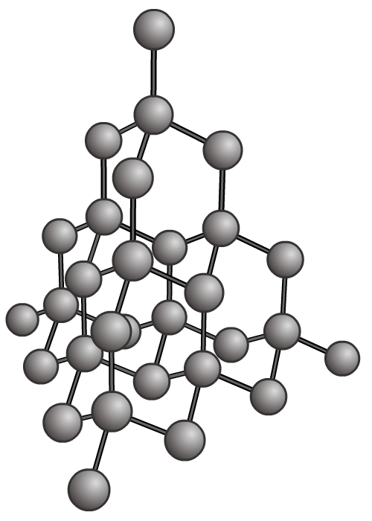
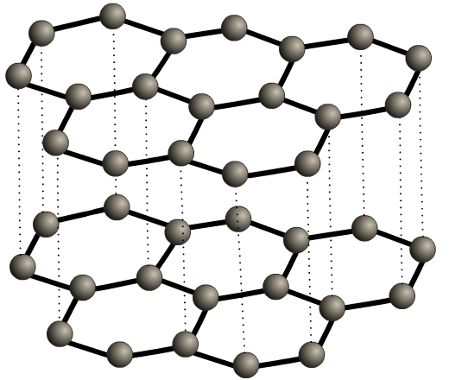
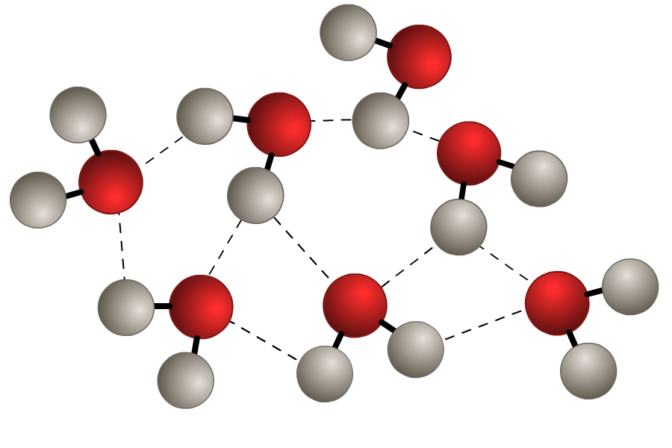
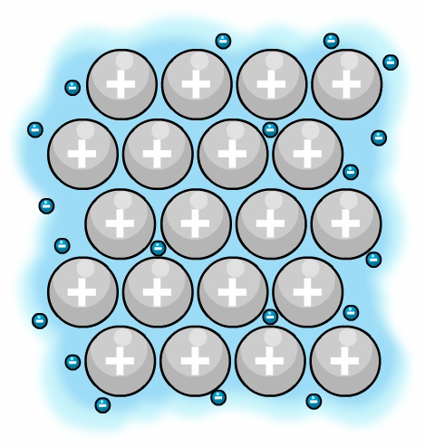
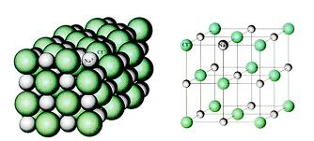
Bonding & Structure
Unit 2
Lesson 9

Slide 2
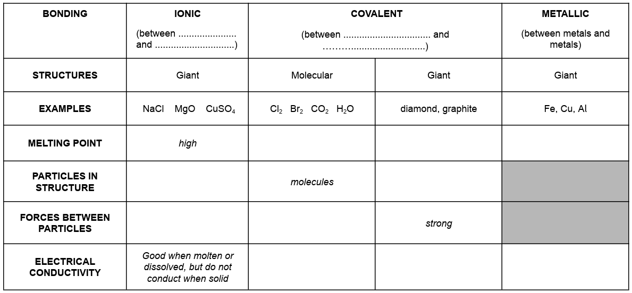
Starter: fill in this table (page 42)
metal
non-metal
non-metal
non-metal
low
high
high
ions
atoms
strong
weak
do not conduct (except graphite)
excellent conductors
do not conduct

Slide 3
Today’s Aim
Unit 2
Lesson 9
By the end of this lesson I will be able to use practical evidence to describe the differences in properties between ionic, covalent and metallic substances

Slide 4

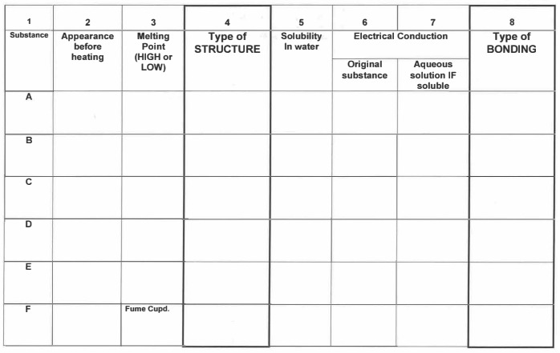
Results (page 43)

Slide 5
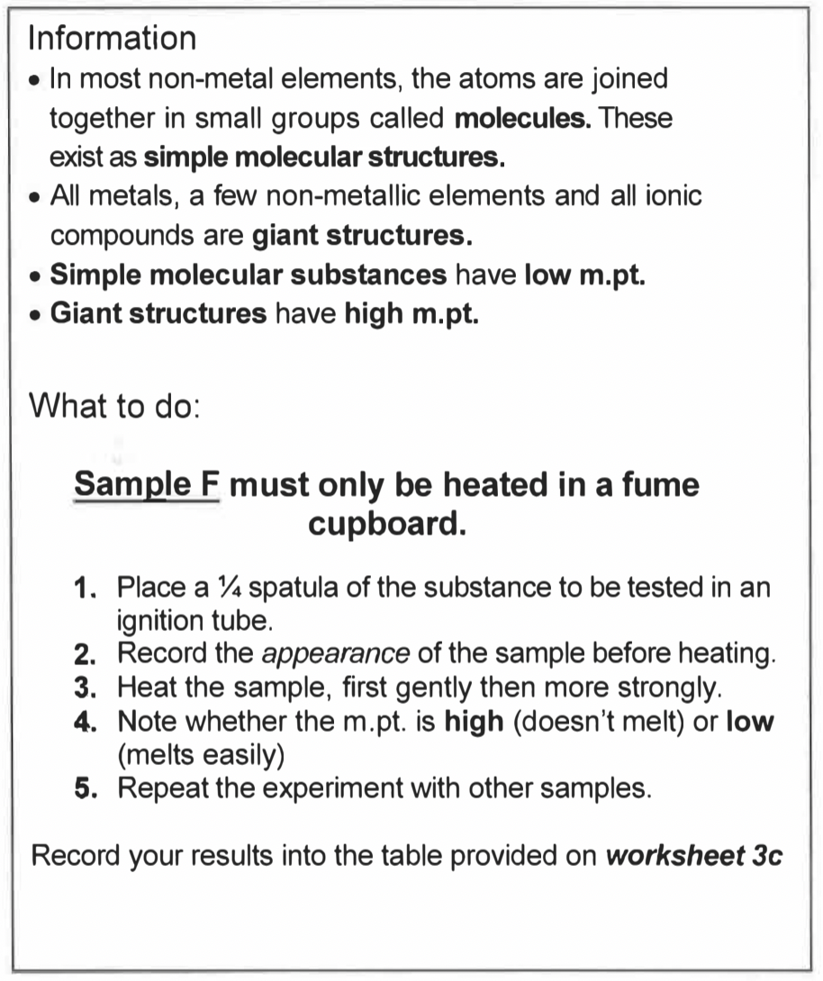
Practical Work (page 43)
Molecular or giant structure?
Although this is a basic practical, you must talk to your partner about what you are doing and explain to each other what the results actually show.
Record your results on page 45.

Slide 6
Results (page 43)
white solid
white solid
red/brown solid
blue solid
brown solid
yellow solid
high
low
high
high
high
low
giant
molecular
giant
giant
giant
molecular

Slide 7
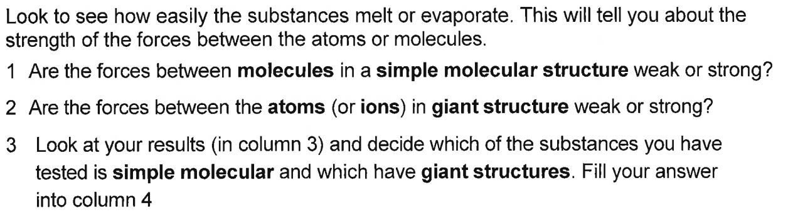
Analysis of your results
Answer the questions at the bottom of page 43

Slide 8
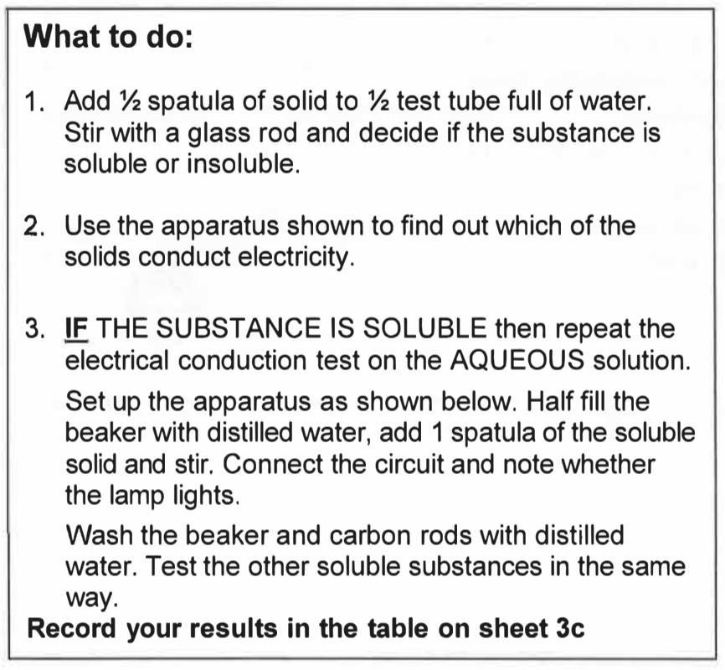
Practical Work (page 44)
Ionic, covalent or metallic?
Again, what you are doing seems simple, but the results give a huge explanation as to the type of structure and bonding present in a given chemical.
Record your results on page 45.

Slide 9
Results (page 43)
white solid
white solid
red/brown solid
blue solid
brown solid
yellow solid
high
low
high
high
high
low
giant
molecular
giant
giant
giant
molecular
soluble
soluble
insoluble
soluble
insoluble
insoluble
no
no
yes
no
no
no
yes
no
n/a
yes
n/a
n/a
ionic
covalent
metallic
ionic
covalent
covalent

Slide 10
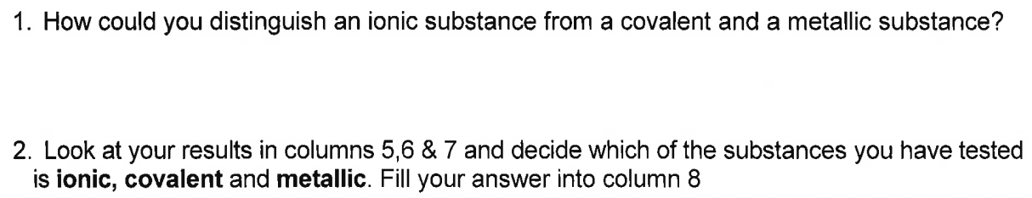
Analysis of your results
Answer the questions at the bottom of page 44

Slide 11
Plenary: questions
On some blank paper, answer the following questions:
Draw a dot and cross diagram for the bonding in potassium oxide (K₂O) and predict the results you would obtain for the experiment you have just carried out.
Draw a dot and cross diagram for the bonding that occurs in phosphorus hydride (PH₃). Predict the results you would obtain in the experiment you have just carried out.
Predict the results you would obtain in this experiment for magnesium.

Slide 12
Plenary: name these!

Slide 13

What you need to know
Unit 2
Lesson 9
Application of the following syllabus statements:
1.37 - 1.43
ionic compounds
1.44 - 1.51
covalent substances
1.52 and 1.54
metallic substances
My Learning

